Slide 1

Oracle 12c: SQL
Chapter 10
Selected Single-Row Functions
©2016. Cengage Learning. All rights reserved.

Slide 2
Objectives
Use the UPPER, LOWER, and INITCAP functions to change the case of field values and character strings
Manipulate character substrings with the SUBSTR and INSTR functions
Nest functions inside other functions
Determine the length of a character string using the LENGTH function
Use the LPAD and RPAD functions to pad a string to a certain width
Use the LTRIM and RTRIM functions to remove specific characters strings
Substitute character string values with the REPLACE and TRANSLATE functions
©2016. Cengage Learning. All rights reserved.

Slide 3
Objectives (continued)
Round and truncate numeric data using the ROUND and TRUNC functions
Return the remainder only of a division operation using the MOD function
Use the ABS function to set numeric values as positive
Use the POWER function to raise a number to a specified power
Calculate the number of months between two dates using the MONTHS_BETWEEN function
Manipulate date data using the ADD_MONTHS, NEXT_DAY, LAST_DAY, and TO_DATE functions
©2016. Cengage Learning. All rights reserved.

Slide 4
Objectives (continued)
Differentiate between CURRENT_DATE and SYSDATE values
Extend pattern matching capabilities with regular expressions
Identify and correct problems associated with calculations involving NULL values using the NVL function
Display dates and numbers in a specific format with the TO_CHAR function
Perform condition processing similar to an IF statement with the DECODE function
Use the SOUNDEX function to identify character phonetics
Convert string values to numeric with the TO_NUMBER function
Use the DUAL table to test functions
©2016. Cengage Learning. All rights reserved.

Slide 5
Terminology
Function – predefined block of code that accepts arguments
Single-row function – returns one row of results for each record processed
Multiple-row function – returns one result per group of data processed (covered in the next chapter)
©2016. Cengage Learning. All rights reserved.

Slide 6
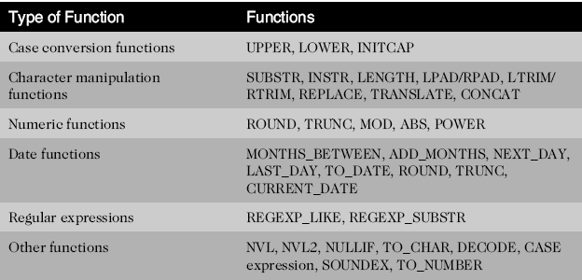
Types of Functions
©2016. Cengage Learning. All rights reserved.

Slide 7
DUAL Table
Dummy table
Consists of one column and one row
Can be used for table reference in the FROM clause

Slide 8
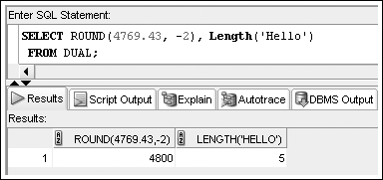
Using DUAL

Slide 9
Case Conversion Functions
Case conversion functions alter the case of data stored in a column or character string
  Used in a SELECT clause, they alter the appearance of the data in the results
  Used in a WHERE clause, they alter the value for comparison
Case conversion functions syntax:
  LOWER(c)
  UPPER(c)
  INITCAP(c) : First letter will be Capital
    INITCP(‘john’) = John
  where c is the character string or field to be converted
Oracle 11g: SQL

Slide 10
Case Conversion Functions
Case conversion functions alter the case of data stored in a column or character string
  Used in a SELECT clause, they alter the appearance of the data in the results
  Used in a WHERE clause, they alter the value for comparison
©2016. Cengage Learning. All rights reserved.

Slide 11
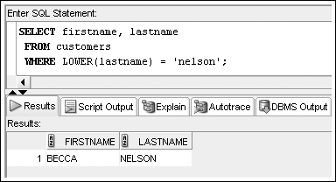
LOWER Function
Used to convert characters to lowercase letters
©2016. Cengage Learning. All rights reserved.

Slide 12
UPPER Function
Used to convert characters to uppercase letters
It can be used in the same way as the LOWER function
  To affect the display of characters, it is used in a SELECT clause
  To modify the case of characters for a search condition, it is used in a WHERE clause
The syntax for the UPPER function is UPPER(c)
  Where c is the character string or field to be converted into uppercase characters
©2016. Cengage Learning. All rights reserved.

Slide 13
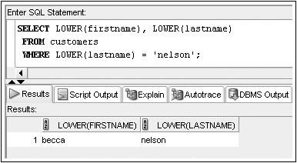
INITCAP Function
Used to convert characters to mixed case
©2016. Cengage Learning. All rights reserved.

Slide 14
Character Manipulation Functions
Character manipulation functions manipulate data by extracting substrings, counting the number of characters, replacing strings, etc.
©2016. Cengage Learning. All rights reserved.

Slide 15
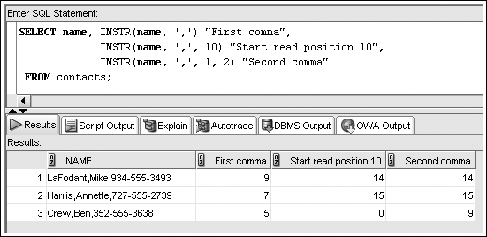
INSTR Function
Returns the location of a substring in a string

Slide 16
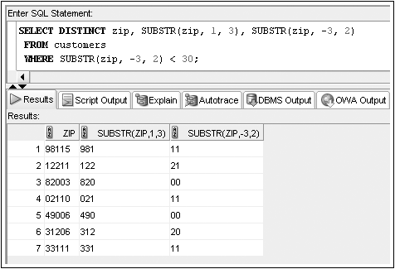
SUBSTR Function
Used to return a substring, or portion of a string
  Minus starts from the last

Slide 17
Parsing Character Strings
To parse, or separate, a single string, use the INSTR function with the SUBSTR function
INSTR function searches a string for a specific substring
  Syntax:
  start_position := INSTR(original_string, substring);
If the function finds the substring, it returns an integer that represents the starting position of the substring within the original string
Example:
  start_position :=
  INSTR(‘Possession is nine-tenths of the law’, ‘-‘);
returns 19
Notes:
If the function does not find the substring, it returns 0.
The PL/SQL program that returns the position of the ‘-’ character in the example on the slide is as follows:
DECLARE
start_position BINARY_INTEGER;
BEGIN
start_position :=INSTR('Possession is nine-tenths of the law', '-');
DBMS_OUTPUT.PUT_LINE(start_position);
END;
/

Slide 18
Parsing Character Strings (cont.)
SUBSTR function
  Extracts specific number of characters from a character string starting at given point
  Syntax:
    extracted_string := SUBSTR(string_variable, starting_point, number_of_characters);
Example:
  start_position :=
  INSTR(‘Possession is nine-tenths of the law’, ‘-‘);
    extracted_string :=
    SUBSTR(‘Possession is nine-tenths of the law’,
    start_position+1, 6);
returns ‘tenths’
Notes:
The PL/SQL program that extracts a substring ‘tenths’ in the example on the slide is as follows:
DECLARE
start_position BINARY_INTEGER;
extracted_string CHAR(10);
BEGIN
start_position:=INSTR('Possession is nine-tenths of the law', '-');
extracted_string:= SUBSTR('Possession is nine-tenths of the law', start_position+1, 6);
DBMS_OUTPUT.PUT_LINE(extracted_string);
END;
/

Slide 19
Parsing Character Strings (cont.)
Use the INSTR function to find the delimiter, which is the character that separates the target substring from the rest of the string
To parse out all of the characters before the delimiter:
  Specify that the starting point is 1.
  Specify that the number_of_characters value is the delimiter position minus 1.
To parse out all of the characters after the delimiter:
  Specify that the starting point is the delimiter position plus 1.
  Specify that the number_of_characters value is the total number of characters in the string minus the delimiter position.
Notes:
You can use the LENGTH function to obtain the total number of characters in the string.

Slide 20
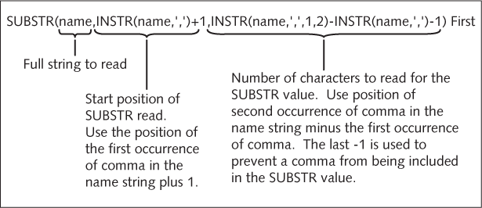
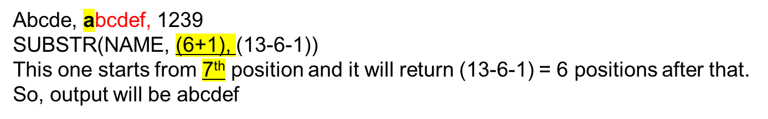
Nesting Functions
©2016. Cengage Learning. All rights reserved.

Slide 21
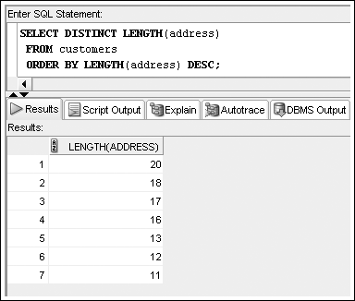
LENGTH Function
Used to determine the number of characters in a string
©2016. Cengage Learning. All rights reserved.

Slide 22
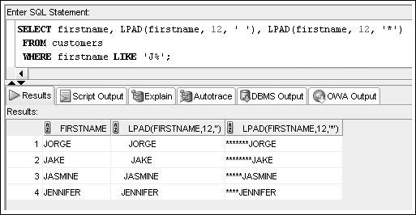
LPAD and RPAD Functions
Used to pad, or fill in, a character string to a fixed width
  Example: In the second column space added, in the third column * added
©2016. Cengage Learning. All rights reserved.

Slide 23
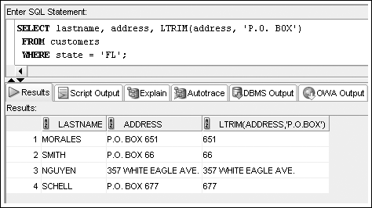
LTRIM and RTRIM Functions
Used to remove a specific string of characters
Left Trim & Right Trim
©2016. Cengage Learning. All rights reserved.

Slide 24
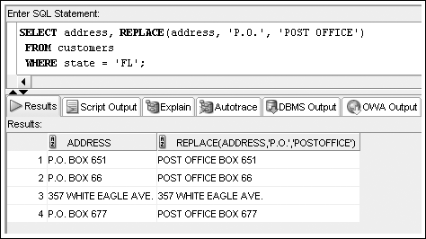
REPLACE Function
Substitutes a string with another specified string
©2016. Cengage Learning. All rights reserved.

Slide 25
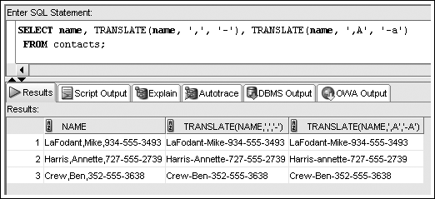
TRANSLATE Function
©2016. Cengage Learning. All rights reserved.

Slide 26
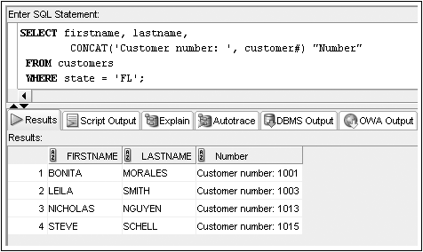
CONCAT Function
Used to concatenate two character strings
©2016. Cengage Learning. All rights reserved.

Slide 27
Number Functions
Allow for manipulation of numeric data
  ROUND
  TRUNC
  MOD
  ABS
©2016. Cengage Learning. All rights reserved.

Slide 28
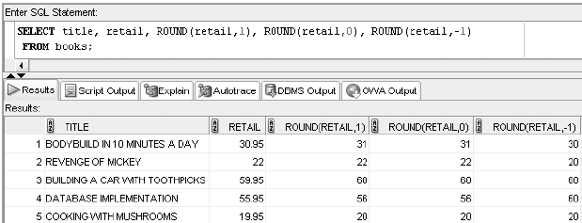
ROUND Function
Used to round numeric columns to a stated precision
  +1 Rounded UP, -1 Rounded Down
©2016. Cengage Learning. All rights reserved.

Slide 29
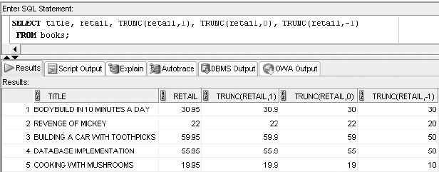
TRUNC Function
Used to truncate a numeric value to a specific position
©2016. Cengage Learning. All rights reserved.

Slide 30
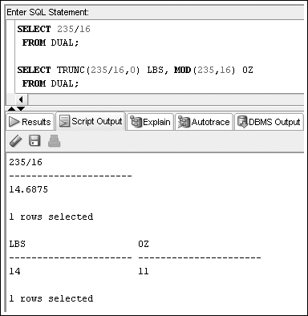
MOD Function
©2016. Cengage Learning. All rights reserved.

Slide 31
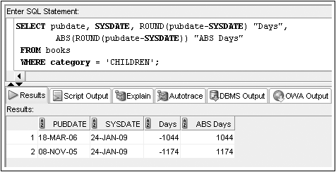
ABS Function
©2016. Cengage Learning. All rights reserved.

Slide 32
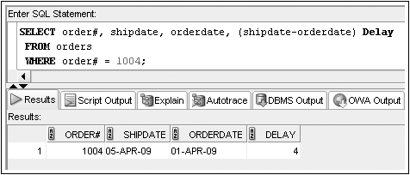
Date Functions
Used to perform date calculations or format date values
Subtract date for number of days difference
©2016. Cengage Learning. All rights reserved.

Slide 33
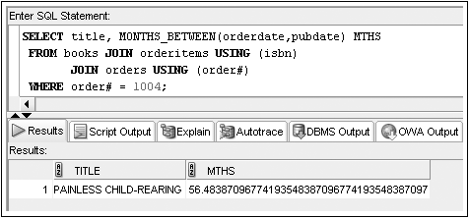
MONTHS_BETWEEN Function
Determines the number of months between two dates
©2016. Cengage Learning. All rights reserved.

Slide 34
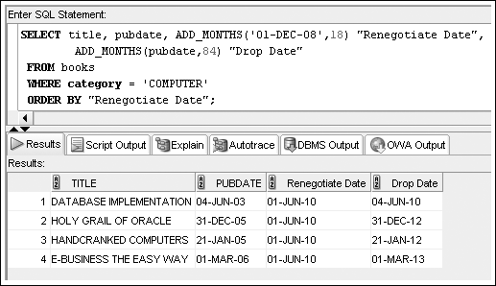
ADD_MONTHS Function
Adds a specified number of months to a date
©2016. Cengage Learning. All rights reserved.

Slide 35
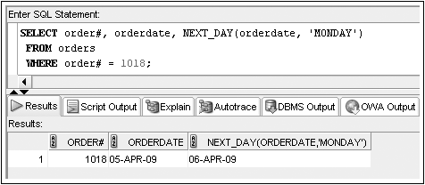
NEXT_DAY Function
Determines the next occurrence of a specified day of the week after a given date
©2016. Cengage Learning. All rights reserved.

Slide 36
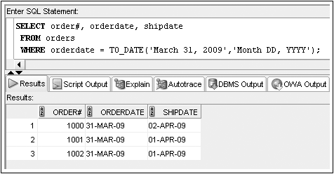
TO_DATE Function
Converts various date formats to the internal format (DD-MON-YY) used by Oracle 11g
©2016. Cengage Learning. All rights reserved.

Slide 37
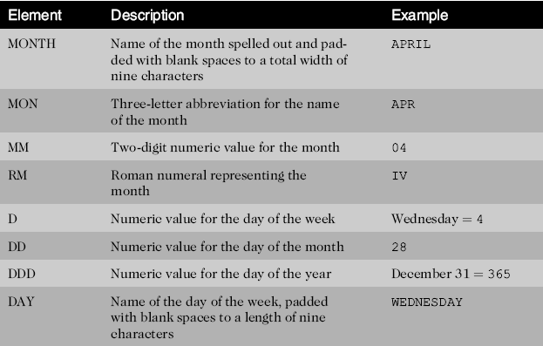
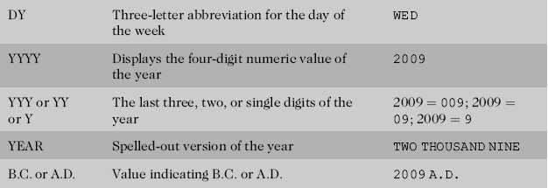
Format Model Elements - Dates
©2016. Cengage Learning. All rights reserved.

Slide 38
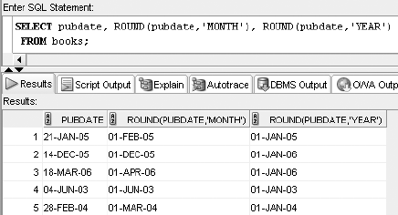
ROUND Function
©2016. Cengage Learning. All rights reserved.

Slide 39
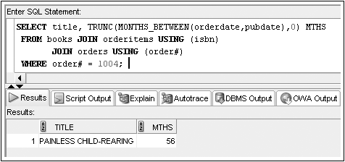
TRUNC Function
©2016. Cengage Learning. All rights reserved.

Slide 40
Regular Expressions
Regular expressions allow the description of complex patterns in textual data
©2016. Cengage Learning. All rights reserved.

Slide 41
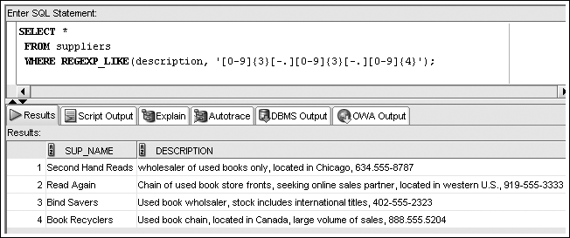
REGEXP_LIKE
©2016. Cengage Learning. All rights reserved.

Slide 42
Other Functions
NVL
NVL2
TO_CHAR
DECODE
SOUNDEX
©2016. Cengage Learning. All rights reserved.

Slide 43
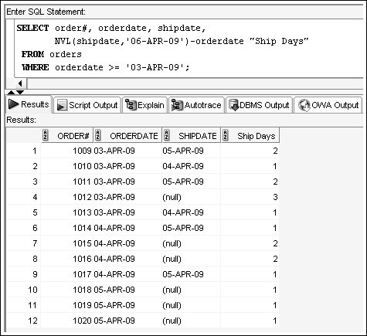
NVL Function
Substitutes a value for a NULL value
©2016. Cengage Learning. All rights reserved.

Slide 44
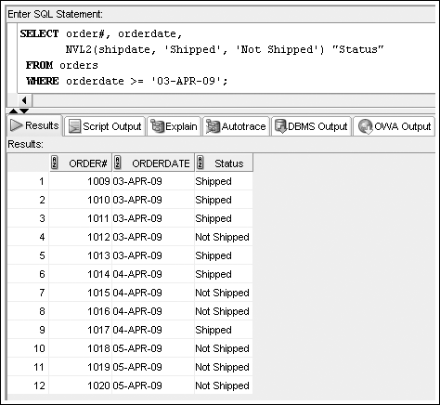
NVL2 Function
Allows different actions based on whether a value is NULL
©2016. Cengage Learning. All rights reserved.

Slide 45
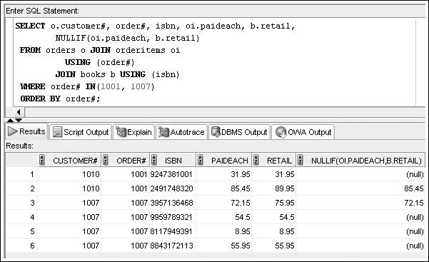
NULLIF Function
©2016. Cengage Learning. All rights reserved.

Slide 46
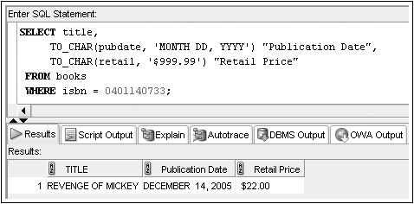
TO_CHAR Function
Converts dates and numbers to a formatted character string
©2016. Cengage Learning. All rights reserved.

Slide 47
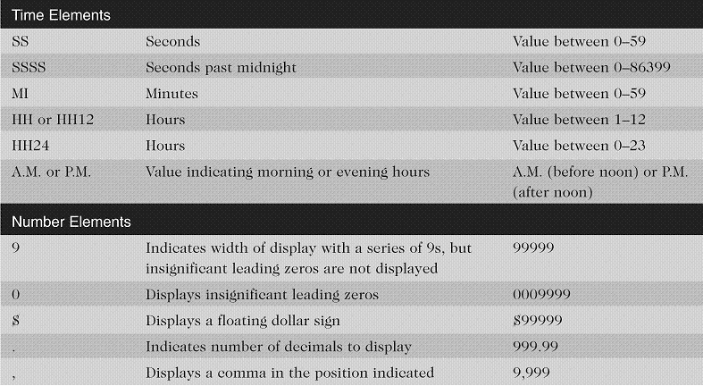
Format Model Elements –
Time and Number
©2016. Cengage Learning. All rights reserved.

Slide 48
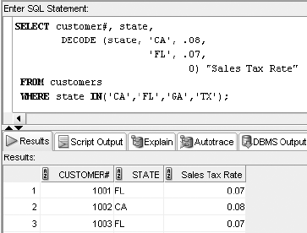
DECODE Function
Determines action based upon values in a list
©2016. Cengage Learning. All rights reserved.

Slide 49
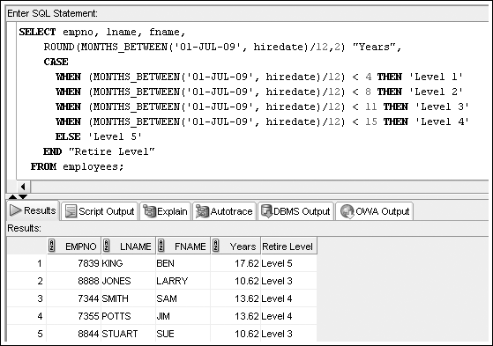
CASE Expression
©2016. Cengage Learning. All rights reserved.

Slide 50
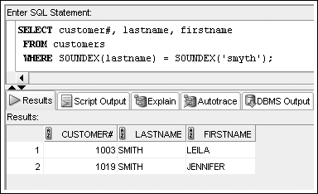
SOUNDEX Function
References phonetic representation of words
©2016. Cengage Learning. All rights reserved.

Slide 51
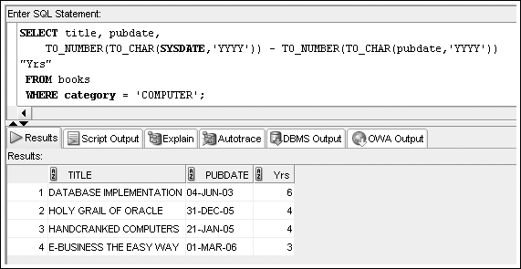
TO_NUMBER Function
©2016. Cengage Learning. All rights reserved.

Slide 52
Summary
Single-row functions return a result for each row or record processed
Case conversion functions such as UPPER, LOWER, and INITCAP can be used to alter the case of character strings
Character manipulation functions can be used to extract substrings (portions of a string), identify the position of a substring in a string, replace occurrences of a string with another string, determine the length of a character string, and trim spaces or characters from strings
Nesting one function within another allows multiple operations to be performed on data
©2016. Cengage Learning. All rights reserved.

Slide 53
Summary (continued)
Simple number functions such as ROUND and TRUNC can round or truncate a number on both the left and right side of a decimal
The MOD function is used to return the remainder of a division operation
Date functions can be used to perform calculations with dates or to change the format of dates entered by a user
Regular expressions enable complex pattern matching operations
The NVL, NVL2, and NULLIF functions are used to address problems encountered with NULL values
©2016. Cengage Learning. All rights reserved.

Slide 54
Summary (continued)
The TO_CHAR function lets a user present numeric data and dates in a specific format
The DECODE function allows an action to be taken to be determined by a specific value
The searched CASE expression enables you to evaluate conditions to determine the resulting value
The SOUNDEX function looks for records based on the phonetic representation of characters
The DUAL table can be helpful when testing functions
©2016. Cengage Learning. All rights reserved.

